Slide 1

AI-Powered Meme Generator for Company Advertisements
Project Guide:
Dr. Atul Kumar Ramotra
(Associate Professor)
CSE(AI&ML)
Project Coordinator:
Mrs. J.Bhargavi
(Assistant Professor)
CSE(AI&ML)
Team Members:
G Sathwika (22AG1A6689)
J Praneeth (22AG1A66B7)
N Manideep (22AG1A66A9)

Slide 2
Agenda
Abstract
Introduction
Literature Survey
Research Gaps
IT Requirements
Existing system
Proposed System
Architecture diagram
UML diagrams
Algorithm working principle
Conclusion

Slide 3
Abstract
The AI-Powered Meme Generator for Company Advertisements is a creative web application that leverages artificial intelligence to produce engaging and brand-focused memes. By inputting a topic, slogan, or product-related phrase, companies can generate humorous captions using advanced NLP models like Llama, BLIP,Stable Diffusion XL, Open CV. The system matches these captions with relevant meme templates or allows custom selection, applying image processing to create professional-quality outputs. The final memes can be downloaded or shared directly, enabling businesses to boost social media presence and drive impactful digital marketing campaigns.

Slide 4
Introduction
The AI-Powered Meme Generator for Company Advertisements is an innovative web-based application that enhances digital marketing through intelligent automation. In today’s social media-driven world, memes have become powerful tools for brands to connect with audiences through humor and relatability. This system uses advanced artificial intelligence and natural language processing (NLP) models like Llama,BLIP,Stable Diffusion XL, Open CV to generate creative and contextually relevant captions from user-provided topics, slogans, or product descriptions. It pairs these captions with suitable meme templates or allows custom selection, applying image processing to ensure high-quality results that strengthens brand visibility and boosts social media presence efficiently.

Slide 5
Literature Survey
S.No | Author Name | Title | Methodology | Findings
1 | Lin Wang, Qimeng Zhang, Youngbin Kim, Ruizheng Wu, Hongyu Jin, Haoke Deng, Pengchu Luo, Chang-Hun Kim | Automatic Chinese Meme Generation Using Deep Neural Networks | A ResNet-50 extracts image features that a fine-tuned GPT-2 uses to generate humorous Chinese meme texts combined with images to create realistic memes. | User studies showed the generated Chinese memes were as humorous and realistic as real ones, proving the model’s effectiveness.
2 | Han Wang, Roy Ka-Wei Lee | MemeCraft: Contextual & Stance-Driven Multimodal Meme Generation | Used AI to collect meme templates, generate funny captions on social topics, and filter out hateful ones to create safe, meaningful memes. | MemeCraft uses AI to make funny and meaningful memes about social topics while removing harmful ones. It works well, but some memes are not always perfectly funny or well-matched with the images.

Slide 6
3 | Suryatej Reddy Vyalla, Vishaal Udandarao, Tanmoy Chakraborty | Memeify: A Large-Scale Meme Generation System | Memeify collected 1.1 million memes to make a large dataset.It used a GPT-2 model to create funny or themed captions, like happy or sad. | Superiority shown across humour, content relevance, and originality.
4 | EunJeong Hwang and Vered Shwartz | MemeCap: A Dataset for Captioning & Interpreting Memes | The MemeCap dataset of ~6.3k annotated memes, including their intended meaning and visual metaphors, to benchmark the ability of existing Vision-Language models on the meme captioning task. | Vision-Language (VL) models perform poorly on the meme captioning task, struggling with visual metaphors and deep interpretation, which validates the need for the new MemeCap dataset for future research.

Slide 7
Research Gaps
  Limited Integration Between Content Generation and Real-Time Optimization:
  Existing systems lack a unified framework that combines creative content generation with real-time adaptive optimization.
  Lack of Adaptive, Real-Time Learning in Existing Optimization Approaches:
  Classical optimization methods fail to adapt dynamically to changing conditions, limiting real-time performance.
  Insufficient Multimodal or Cross-Domain Capabilities:
  Current tools do not integrate multimodal content creation with optimization techniques for context-aware, user-specific outputs.

Slide 8
Existing System
Supermeme.ai – Focuses on Text-to-Meme generation, allowing marketers to turn any phrase or idea into a meme in seconds. It stands out for its API access for workflow automation and its extensive multilingual support (over 110 languages), making it suitable for global campaigns.
Classical Optimization-Based Methods - Some systems use optimization techniques like gradient descent or genetic algorithms to plan efficient trajectories. These methods improve accuracy or energy efficiency but are often computationally expensive and cannot adapt in real-time to dynamic conditions.

Slide 9
Proposed Method
In this project, a Generative AI model is trained on a massive, curated dataset of viral, brand-safe memes and corporate content to create advertisements. The system uses Natural Language Processing (NLP) to analyze a brand's input (e.g., product, desired tone, target trend) and uses a visual template engine to select a relevant meme format. A reinforced learning module (like the Q-table in the example) constantly adjusts the humor-to-brand-safety ratio based on user engagement, allowing the AI to learn the best combination of caption, image, and cultural reference to maximize virality and brand compliance with minimal risk of negative backlash, without requiring continuous human review.

Slide 10
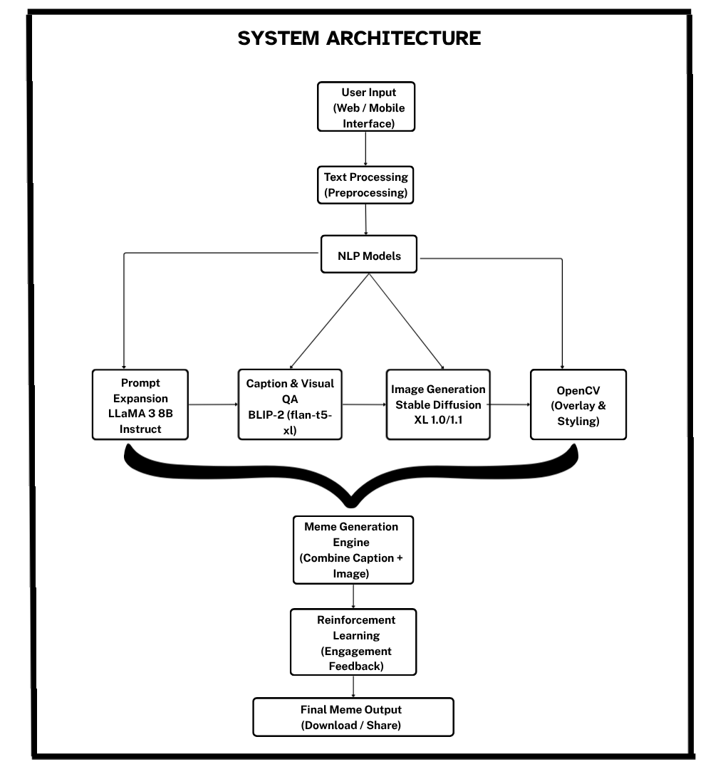
Architecture diagram

Slide 11
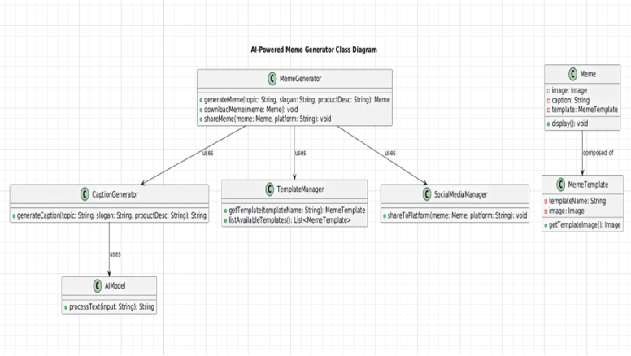
UML diagrams
CLASS DIAGRAM

Slide 12
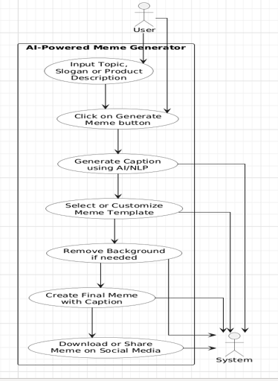
USE CASE
DIAGRAM

Slide 13
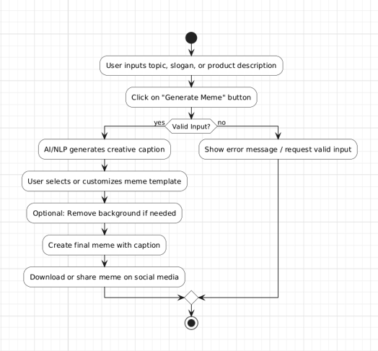
ACTIVITY
DIAGRAM

Slide 14
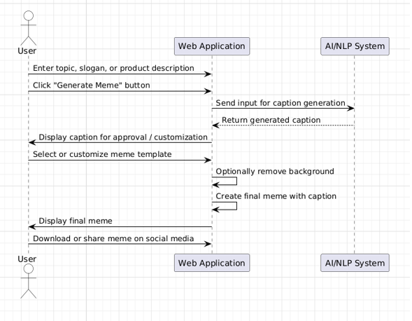
SEQUENCE
DIAGRAM

Slide 15
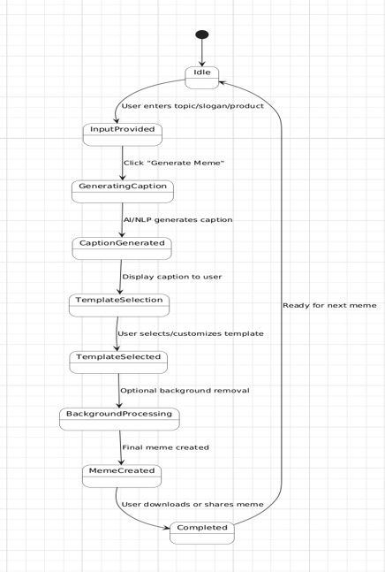
STATE CHART
DIAGRAM

Slide 16
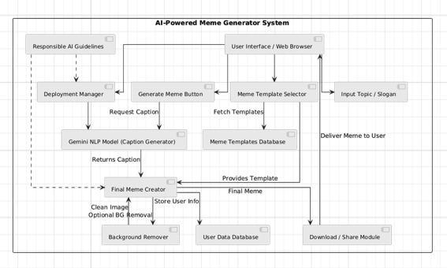
COMPONENT DIAGRAM

Slide 17
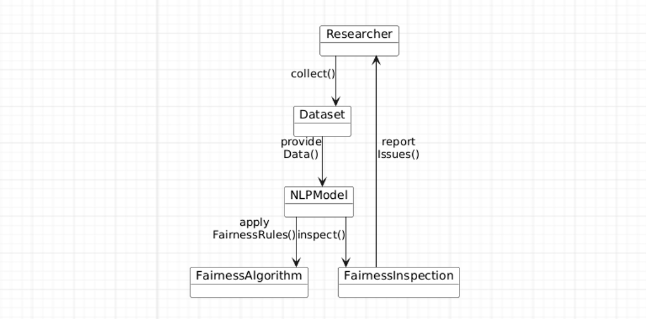
COLLABORATION DIAGRAM

Slide 18
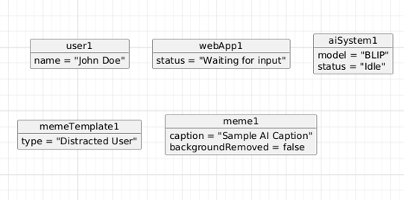
OBJECT DIAGRAM

Slide 19
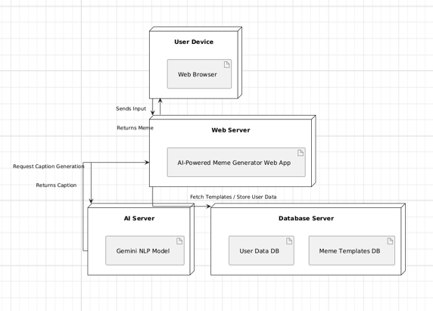
DEPLYMENT DIAGRAM

Slide 20
Algorithm working principle
1. System Initialization & Input Processing
3. Caption Generation & Meme Composition
Load Llama 3 8B, BLIP-2, Stable Diffusion XL, and OpenCV libraries.
Load meme template database and set up UI/Backend.
Receive user input (topic/slogan/phrase).
Preprocess text: clean, normalize, extract keywords, sentiment, and context.
Use BLIP-2 to generate witty captions or taglines.
Rank captions based on humor, relevance, and brand safety.
Use OpenCV + Pillow to overlay text, apply formatting, adjust contrast, and style the meme.
Render the final high-resolution meme image.
2. Prompt Expansion & Image Generation
4. Output Delivery
Use Llama 3 8B to expand the input into a creative meme-style prompt.
Select a meme template automatically or based on user choice.
Generate or enhance meme images using Stable Diffusion XL.
Display the meme via Streamlit interface.
Provide download, share, and save options.

Slide 21
IT Requirements
Software Requirements
Hardware Requirements
Programming Languages:
• Python (preferred for ML/AI libraries)
• React.js, HTML, CSS, JS (for front-end interfaces)
Frameworks and Libraries:
• Llama 3 8B Instruct (Meta) (for Prompt Expansion)
• Stable Diffusion XL 1.0 / 1.1 (for Image Generation)
• BLIP-2 (for Caption Generation)
• OpenCV (for Overlay & Styling)
Processor (CPU):
• Minimum: Intel i3 or AMD Ryzen 3
• Recommended: Intel i5/i7 or AMD Ryzen 5/7
RAM:
• Minimum: 8 GB
• Recommended: 16 GB or higher (for faster training and multitasking)
Graphics Card (GPU):
• Recommended for deep learning: NVIDIA RTX 2060 or above
• CUDA support preferred for model training

Slide 22
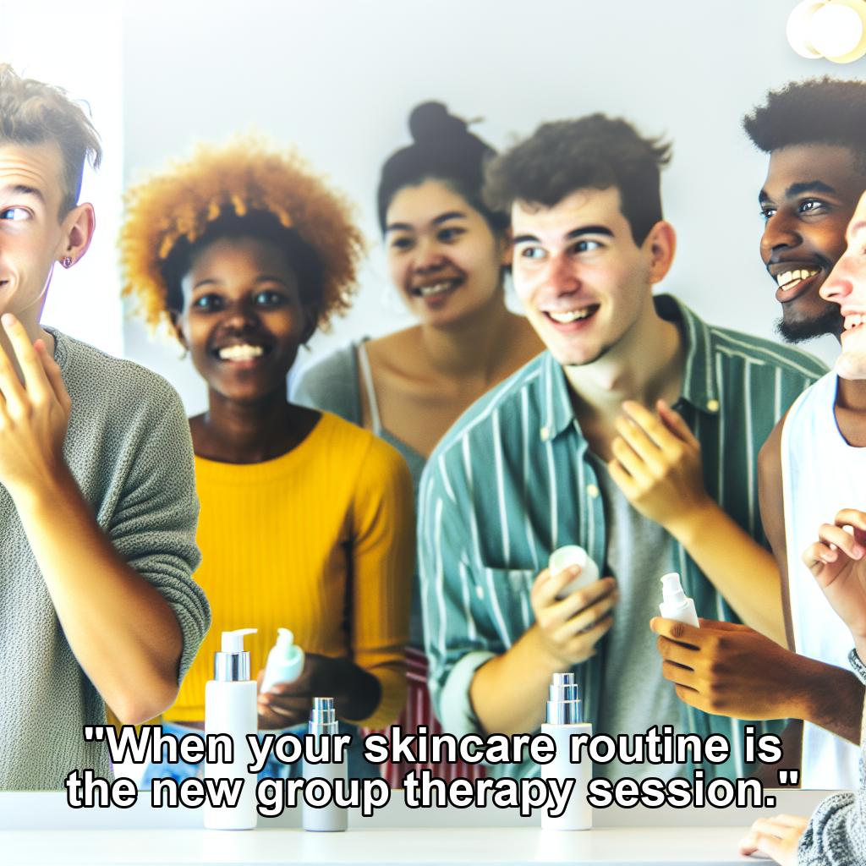

Sample Input/Output
User Input:
Dot and key skin care product is used by the young generation people
Give me the maaza product ad meme

Slide 23
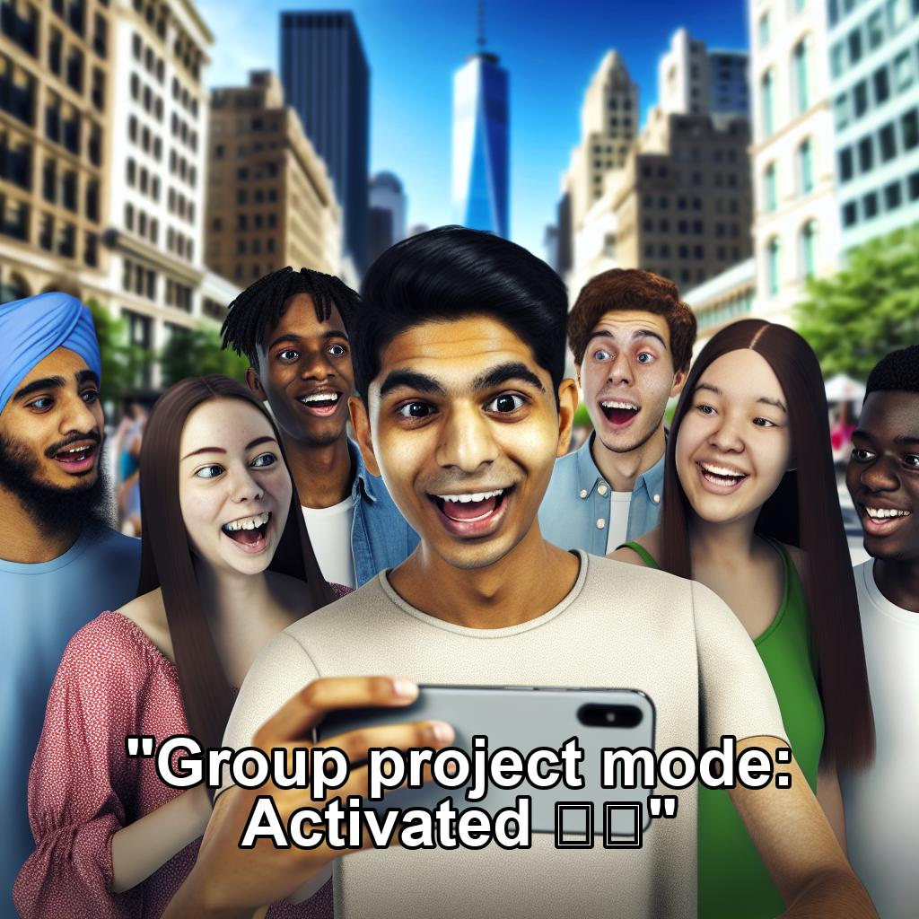
User Input :
Promote the Iphone brand

Slide 24
Conclusion
The AI-Powered Meme Generator for Company Advertisements provides an efficient and creative solution for enhancing digital marketing. By using NLP and AI-driven caption generation, the system helps companies create memes that are humorous, engaging, and relevant to their brand message. The automated workflow reduces manual effort while maintaining high-quality content suitable for social media platforms. This approach strengthens brand visibility, increases audience engagement, and supports effective communication in a relatable manner. Overall, the project demonstrates how artificial intelligence can simplify creative marketing tasks and offers a practical tool for businesses looking to innovate in promotional strategies.

Slide 25
“Thank you for your time.”

